Slide 1
Verification and Validation of Safety Critical Systems
Presented By
Madhusmita Das
Guided By
Dr. Biju R. Mohan

Slide 2
Verification and Validation process
In any process driven system or software development the verification process verifies if the system or software is being developed as per the requirement.
The validation process confirms the system or software is developed as per the requirement.
The verification process is carried out during the different developmental phases of the system or the software.
The validation process is done at the end of the system or software development.
50-70% of the developmental resources are consumed by this process. This process consists of reviews, analysis, checklist generation and testing.

Slide 3
Verification and Validation

Slide 4
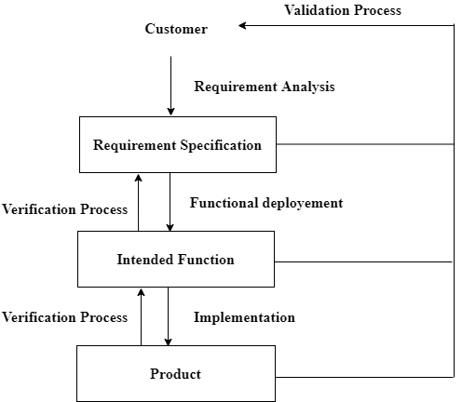
Verification and Validation Process

Slide 5
Modeling and simulation procedure

Slide 6
Safety-critical systems
A system whose functionality affects the safety of the environment, human life, or the nation’s interests is a safety critical system.
More and more systems are safety-critical systems, such as avionics systems, grid cyber-physical systems (GCPSs), automotive systems and medical systems, etc. The failure or mishap of a safety-critical system may lead to the damage of systems or equipment, it may even result at the loss of life and personal injury. It also can give rise to large amounts of economic losses. Thus, safety analysis has attracted much more attention.

Slide 7
Guideline for safety analysis
Many standards provide the guideline for safety analysis, such as, ARP 4761 , MIL-STD-882D, DO-178C, ISO 26262, IEC 61508, DO-333 , etc. In DO-333, formal methods, are recommended to ensure system safety during the system development. It is necessary to integrate formal methods with safety analysis approaches.

Slide 8
Categories of SCS
Safety critical software
Safety critical system
Safety critical software system

Slide 9
Verification Techniques
Dynamic Testing
- Functional testing
- Structural testing
- Random testing
Static testing
-Consistency techniques
-Measurement techniques

Slide 10
Validation Techniques
Formal Method
Fault Injection
-Hardware fault injection
-Software fault injection
Dependability analysis
-Hazard analysis
-Risk analysis

Slide 11
Formal methods and critical systems
The development of critical systems is one of the ‘success’ stories for formal methods
Formal methods are mandated in Britain for the development of some types of safety-critical software for defence applications
There is not currently general agreement on the value of formal methods in critical systems development
Formal methods and validation
Specification validation
Developing a formal model of a system requirements specification forces a detailed analysis of that specification and this usually reveals errors and omissions
Mathematical analysis of the formal specification is possible and this also discovers specification problems
Formal verification
Mathematical arguments (at varying degrees of rigour) are used to demonstrate that a program or a design is consistent with its formal specification

Slide 12
Motivation
For every safety critical system development verification and validation plays an important role in assuring safety. The output of this process gives us the satisfactory fulfillment of the safety requirements.
To make automation in verification and validation, formal method is introduced as it is cost effective.
As testing cannot complement replaced by formal method so combining formal method and testing is a cost effective approach for system verification and validation.
A lot of testing methods are available such as Ontology based testing, Model-based testing, Regression testing etc.

Slide 13
Safety proofs
Safety proofs are intended to show that the system cannot reach in unsafe state
Weaker than correctness proofs which must show that the system code conforms to its specification
Generally based on proof by contradiction
Assume that an unsafe state can be reached
Show that this is contradicted by the program code
May be displayed graphically
Construction of a safety proof
Establish the safe exit conditions for a component or a program
Starting from the END of the code, work backwards until you have identified all paths that lead to the exit of the code
Assume that the exit condition is false
Show that, for each path leading to the exit that the assignments made in that path contradict the assumption of an unsafe exit from the component

Slide 14
Use Case:
Insulin pump systems

Slide 15
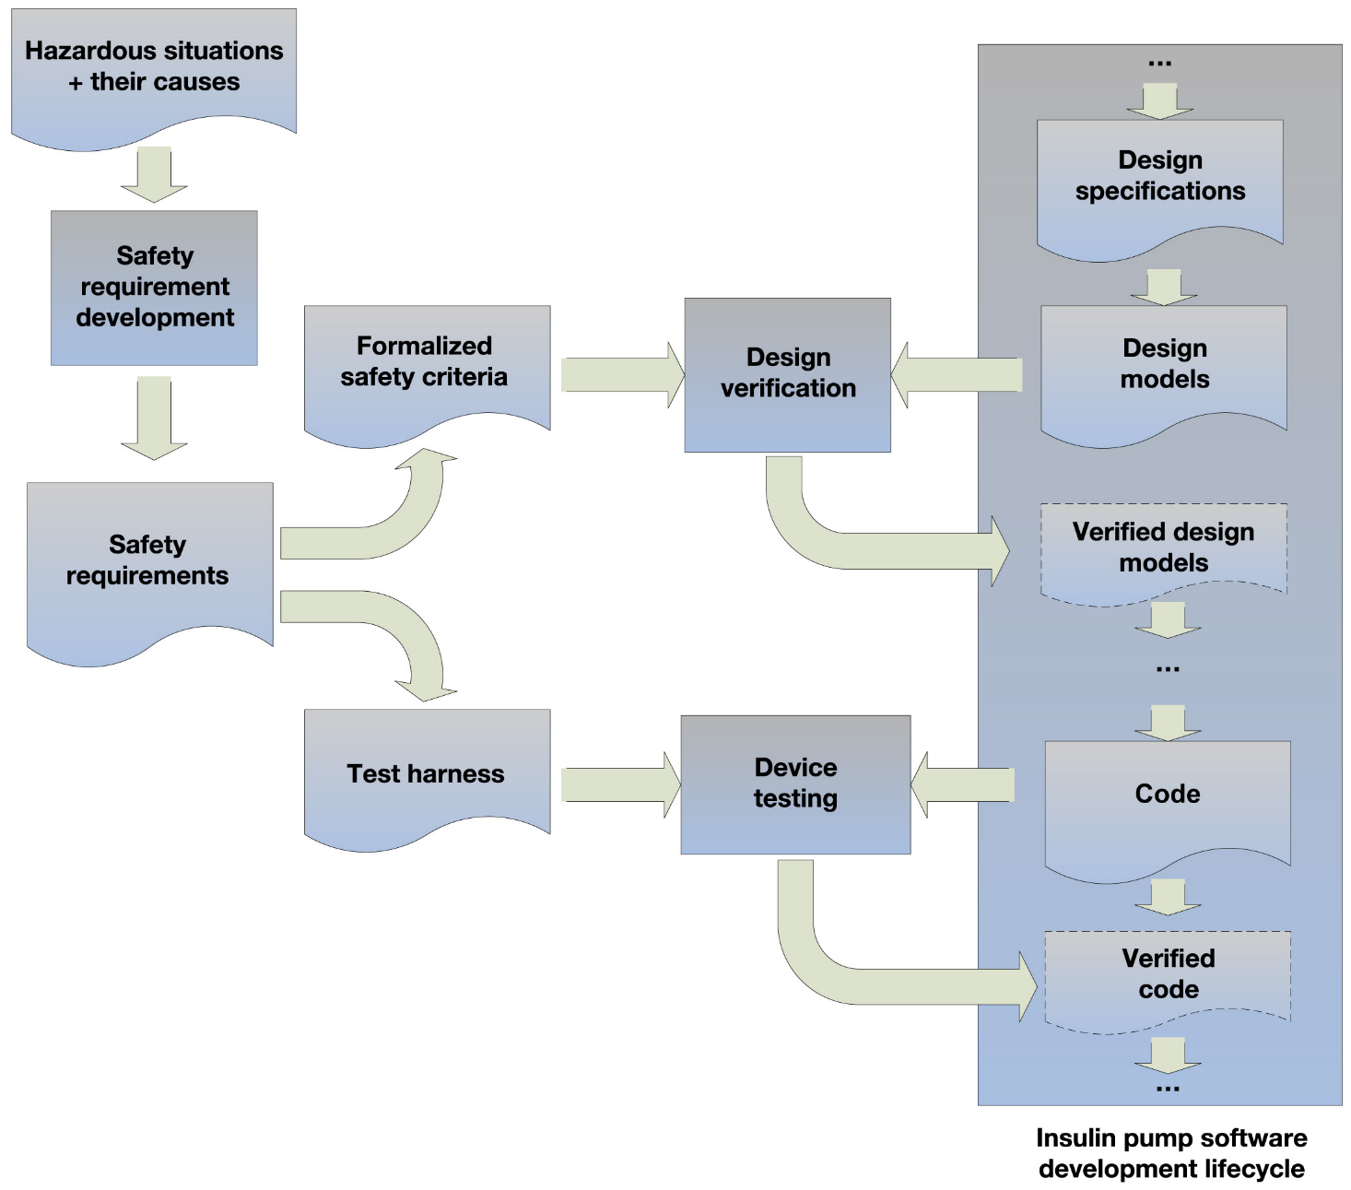
Integrating safety requirements into software development lifecycle.

Slide 16
Insulin system hazards
insulin overdose or under dose (biological)
power failure (electrical)
machine interferes electrically with other medical equipment such as a heart pacemaker (electrical)
parts of machine break off in patient’s body(physical)
infection caused by introduction of machine (biol.)
allergic reaction to the materials or insulin used in the machine (biol).

Slide 17
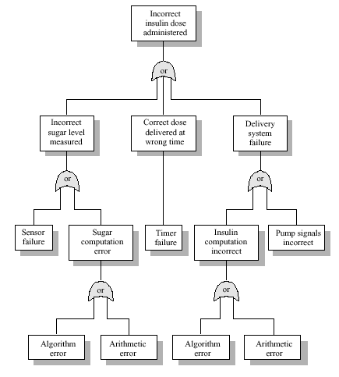
Fault tree for software hazards

Slide 18
Safety proofs
Safety proofs are intended to show that the system cannot reach in unsafe state
Weaker than correctness proofs which must show that the system code conforms to its specification
Generally based on proof by contradiction
Assume that an unsafe state can be reached
Show that this is contradicted by the program code

Slide 19
Insulin delivery system
Safe state is a shutdown state where no insulin is delivered
If hazard arises, shutting down the system will prevent an accident
Software may be included to detect and prevent hazards such as power failure
Consider only hazards arising from software failure
Arithmetic error The insulin dose is computed incorrectly because of some failure of the computer arithmetic
Algorithmic error The dose computation algorithm is incorrect

Slide 20
Arithmetic errors
Use language exception handling mechanisms to trap errors as they arise
Use explicit error checks for all errors which are identified
Avoid error-prone arithmetic operations (multiply and divide). Replace with add and subtract
Never use floating-point numbers
Shut down system if exception detected (safe state)

Slide 21
Algorithmic errors
Harder to detect than arithmetic errors. System should always err on the side of safety.
Use reasonableness checks for the dose delivered based on previous dose and rate of dose change.
Set maximum delivery level in any specified time period.
If computed dose is very high, medical intervention may be necessary anyway because the patient may be ill.

Slide 22
Procedure for Insulin delivery code
// The insulin dose to be delivered is a function of blood sugar level, the previous dose // delivered and the time of delivery of the previous dose
currentDose = computeInsulin () ;
// Safety check - adjust currentDose if necessary
if (previousDose == 0) { // if statement 1
if (currentDose > 16)
currentDose = 16 ;
}
else
if (currentDose > (previousDose * 2) )
currentDose = previousDose * 2 ;
if ( currentDose < minimumDose ) // if statement 2
currentDose = 0 ; // then branch
else if ( currentDose > maxDose ) // else branch
currentDose = maxDose ;
administerInsulin (currentDose) ;

Slide 23
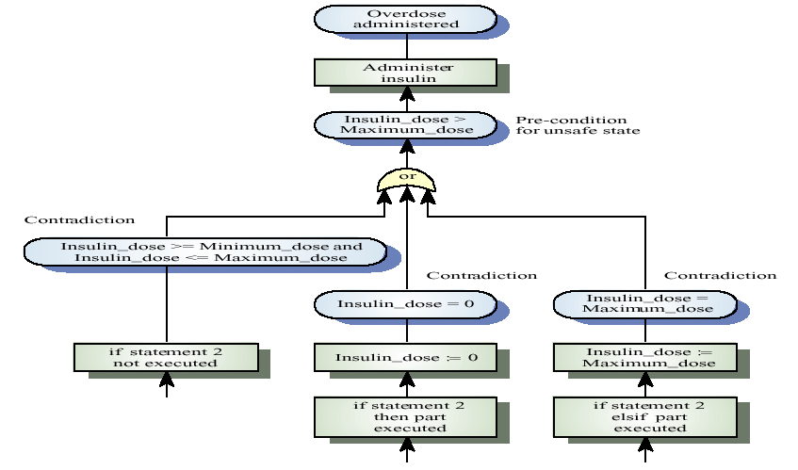
Informal safety proof Fault tree

Slide 24
System testing
System testing of the software has to rely on simulators for the sensor and the insulin delivery components.
Test for normal operation using an operational profile. Can be constructed using data gathered from existing diabetics.
Testing has to include situations where rate of change of glucose is very fast and very slow.
Test for exceptions using the simulator.

Slide 25
Safety assertions
Predicates included in the program indicating conditions which should hold at that point.
May be based on pre-computed limits e.g. number of insulin pump increments in maximum dose.
Used in formal program inspections or may be pre-processed into safety checks that are executed when the system is in operation.

Slide 26
Safety assertions
static void administerInsulin ( ) throws SafetyException {
int maxIncrements = InsulinPump.maxDose / 8 ;
int increments = InsulinPump.currentDose / 8 ;
// assert currentDose <= InsulinPump.maxDose
if (InsulinPump.currentDose > InsulinPump.maxDose)
throw new SafetyException (Pump.doseHigh);
else
for (int i=1; i<= increments; i++) {
generateSignal () ;
if (i > maxIncrements)
throw new SafetyException ( Pump.incorrectIncrements);
} // for loop
} //administerInsulin

Slide 27
References
Singh N.K., Wang H., Lawford M., Maibaum T.S.E., Wassyng A. (2015) Stepwise Formal Modelling and Reasoning of Insulin Infusion Pump Requirements. In: Duffy V. (eds) Digital Human Modeling. Applications in Health, Safety, Ergonomics and Risk Management: Ergonomics and Health. DHM 2015. Lecture Notes in Computer Science, vol 9185. Springer, Cham. https://doi.org/10.1007/978-3-319-21070-4_39
Zhang, Yi & Jetley, Raoul & Jones, Paul & Ray, Arnab. (2011). Generic Safety Requirements for Developing Safe Insulin Pump Software. Journal of diabetes science and technology. 5. 1403-19. 10.1177/193229681100500612.

Slide 28
Tools and Languages
Languages used are System Process Engineering Meta-model Specification Version 2.0, UML, TLA+, Z, Petri Nets (PNs) etc.
To make automation many tools has already been developed known as UPPAAL, TIMES, PRISM, KLEE, Frama-C, Prema, ASSERTTM etc.

Slide 29
Thank You
Q & A

